Slide 1

Lecture 13
MFDS Team

Slide 2
Introduction
In the previous lecture, we discussed dimensionality reduction using PCA
In this lecture, we will see the use of linear algebra in practical implementation of PCA.
We will also study the challenges encountered when PCA is used in problems of larger dimensions.
Finally, we elaborate the key steps of PCA in practice.

Slide 3
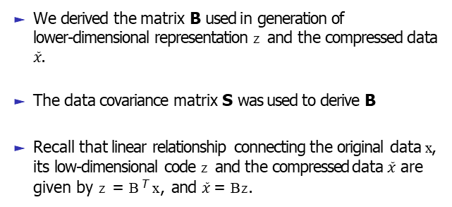
Revision of PCA problem
We derived the matrix B used in generation of
lower-dimensional representation z and the compressed data
$\tilde{x}$.
The data covariance matrix S was used to derive B
Recall that linear relationship connecting the original data x, its low-dimensional code z and the compressed data $\tilde{x}$ are given by z = B^{T} x, and $\tilde{x}$= Bz.

Slide 4
Recall : Example
Consider the data given below:
x1 | x2 | x3 | x4 | x5 | x6 | x7 | x8 | x9 | Mean
1.11 | 1.21 | 1.36 | 1.49 | 1.63 | 1.68 | 1.83 | 1.88 | 1.95 | 1.571
10 | 12 | 13 | 15 | 16 | 17 | 18 | 19 | 20 | 15.555
The Data Covariance matrix is given by
1
0.079 0.888
0.888 10.024
T
S = XX =
9
The largest eigenvalue of S is λ = 10.103.
0.088 .
The corresponding eigenvector is
0.996

Slide 5
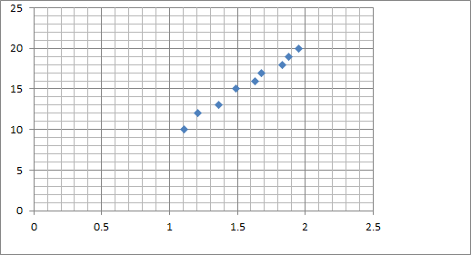
Data Plot
The compressed or the reduced data is then given by z = b^{T} X
1
z1 | z2 | z3 | z4 | z5 | z6 | z7 | z8 | z9
-5.57 | -3.57 | -2.56 | -0.56 | 0.45 | 1.45 | 2.46 | 3.46 | 4.46

Slide 6
Eigenvector Computation and Low Rank Approximation
In the previous sections, we obtained the basis of the principal subspace as the eigenvectors that are associated with the largest eigenvalues of the data covariance matrix.
1
N
N
S =
Σ
x x
T
n n
i =1
Equivalently we get
1
S = XX^{T}
N
Note that X = [x₁, ....., x_{N} ] ∈ R^{D×N}
Note that X is a D × N matrix,

Slide 7

Eigenvector Computation and Low Rank Approximation
To get the eigenvalues and the corresponding eigenvectors of S, we can follow two approaches
We can perform an eigen-decomposition and compute the eigenvalues and eigenvectors of S directly.
We can also use a singular value decomposition.
Since S is symmetric and factorizes into XX^{T} , the eigenvalues of S are the squared singular values of X.
Assume the SVD of X as X = UΣV ^{T} . Then
1 1
S = XX^{T} = UΣΣ^{T} U^{T}
N N
[Since V is orthogonal $V^{T}V=I$]

Slide 8
Example of PCA Revisited
Consider the data given below:
x1 | x2 | x3 | x4 | x5 | x6 | x7 | x8 | x9 | Mean
1.11 | 1.21 | 1.36 | 1.49 | 1.63 | 1.68 | 1.83 | 1.88 | 1.95 | 1.57
10 | 12 | 13 | 15 | 16 | 17 | 18 | 19 | 20 | 15.55
Consider X = UΣV ^{T}
where
0.0883 0.9961
0.9961 −0.0883
U =
9.535 0 0 0 0 0 0 0 0
0 0.084 0 0 0 0 0 0 0
Σ =

Slide 9
Eigenvector Computation and Low Rank Approximation
The columns of U are the eigenvectors of S .
The eigenvalues λ_{d} of S are related to the singular values of X via
_{σ}2
_{λd =} d
N
This relationship between the eigenvalues of S and the singular values of X provides the connection between the maximum variance view and the singular value decomposition.

Slide 10
Best Rank-M approximation
To maximize the variance of the projected data PCA chooses the columns of U to be the eigenvectors that are associated with the M largest eigenvalues of the data covariance matrix S
The Eckart-Young theorem offers a direct way to estimate the low-dimensional representation.
Consider the best rank-M approximation of X defined as X˜_{M}
^{X˜}M ^{= argmin}rank(A)<=M
X − A ₂

Slide 11
Best Rank-M approximation
The Eckart-Young theorem states that the best rank M approximation X˜_{M} is given by truncating the SVD at the top-M singular value.
X˜_{M} = U_{M} Σ_{M}V ^{T}
M
U_{M} is an orthogonal matrix
V_{M} is an orthogonal matrix
Σ_{M} has M largest singular values of X as diagonal entries

Slide 12
Practical Aspects of PCA
Finding eigenvalues and eigenvectors is also important in other fundamental machine learning methods that require matrix decompositions
In theory we can solve for the eigenvalues as roots of the characteristic polynomial.
However for matrices larger than 4 by 4 this is not possible because we would need to find the roots of polynomial of degree 5 or higher.

Slide 13
Practical Aspects of PCA
However the Abel-Ruffini theorem states that there exists no algebraic solution to this problem for polynomials of degree 5 or more.
Therefore, in practice, solve for eigenvalues or singular values using iterative methods, which are implemented in all modern packages for linear algebra
In many applications we only require a few eigenvectors.

Slide 14
Practical Aspects of PCA
It would be wasteful to compute the full decomposition,and then discard all eigenvectors with eigenvalues that are beyond the first few.
It turns out that if we are interested in only the first few eigenvectors (with the largest eigenvalues), then iterative processes, which directly optimize these eigenvectors, are computationally more efficient than a full eigen-decomposition

Slide 15
Practical Aspects of PCA
In the extreme case of only needing the first eigenvector, a simple method called the power iteration is very efficient.
Power iteration chooses a random vector x₀ that is not in the null space of S and follows the iteration for k = 0, 1, ...
Sx_{k}
x =
Sx_{k}
k+1
This sequence of vectors converges to the eigenvector associated with the largest eigenvalue of S.

Slide 16
PCA in High Dimension
In order to do PCA, we need to compute the data covariance matrix.
In D dimensions, the data covariance matrix is a D × D
matrix.
Computing the eigenvalues and eigenvectors of this matrix is computationally expensive as it scales cubically in D.
Therefore, PCA, as we discussed earlier, will be infeasible in very high dimensions.
In the following, we provide a solution to this problem for the case that we have substantially fewer data points than dimensions, i.e., N << D

Slide 17
PCA in High Dimension
Assume we have a centered dataset x₁, ..., x_{N} ,where x_{i} ∈ R^{D} .
Then the data covariance matrix is given as S = ¹ XX^{T}
N
Consider the eigenvectors equation of S
Sb_{m} = λ_{m}b_{m}
By substituting the definition of S
1
XX^{T} b = λ b
N
m m m

Slide 18
PCA in High Dimension
Multiply by X^{T} , we get
1
X^{T} XX^{T} b = λ X^{T} b
N
m m m
If c_{m} = X^{T} b_{m}, then
1
X^{T} Xc = λ c
N
m m m
The nonzero eigenvalues of XX^{T} is same as the nonzero eigenvalues of X^{T} X .

Slide 19
PCA in High Dimension
Now that we have the eigenvectors of ¹ X^{T} X ,
N
1
X^{T} Xc = λ c
N
m m m
We need to derive the eigenvectors of XX^{T} , which we still need for PCA
Multiply by X to get
1
XX^{T} Xc = λ Xc
N
m m m
Here, we recover the data covariance matrix again.
This means that we recover Xc_{m} as an eigenvector of S.

Slide 20
Key Steps of PCA in Practice
In the following, we will go through the individual steps of PCA using a running example.
We are given a two dimensional dataset
we want to use PCA to project it onto a one-dimensional subspace.
The key steps are given below
Mean subtraction
Standardization
Eigen-decomposition of the covariance matrix
Projection

Slide 21
Key Steps of PCA in Practice
Mean subtraction
We start by centering the data by computing the mean of the dataset and subtracting it from every single data point.
This ensures that the dataset has mean 0.
Mean subtraction is not strictly necessary but reduces the risk of numerical problems

Slide 22
Key Steps of PCA in Practice
Standardization
Divide the data points by the standard deviation σ_{d} of the dataset for every dimension d .
Now the data is unit free, and it has variance 1 along each axis, which is indicated by the standardization
This step completes the standardization of the data.

Slide 23
Key Steps of PCA in Practice
Eigen-decomposition of the covariance matrix
Compute the data covariance matrix
Compute its eigenvalues and corresponding eigenvectors.
Since the covariance matrix is symmetric, the spectral theorem states that we can find an orthonormal basis of eigenvectors.
The eigenvectors are scaled by the magnitude of the corresponding eigenvalue.

Slide 24
Key Steps of PCA in Practice
Projection
We can project any data point x∗ ∈ R^{d} onto the principal subspace:
To get this right, we need to standardize x∗ using the mean and standard deviation of the training data in the d th dimension
_{x} (d ) _{− µ}
(d ) ₌ ∗ d ,
x∗
d = 1, ...., D
σ_{d}
3. Here x ^{(d )} is the d th component of x∗.
∗

Slide 25
Key Steps of PCA in Practice
We obtain the projection as
x˜ = BB^{T} x∗
The coordinates are
z∗ = B^{T} x∗
with respect to the basis of the principal subspace.
Here, B is the matrix that contains the eigenvectors that are associated with the largest eigenvalues of the data covariance matrix as columns.

Slide 26
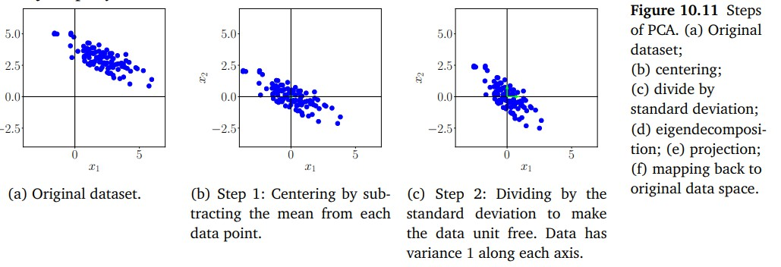
Key Steps of PCA in Practice
Figure: PCA

Slide 27
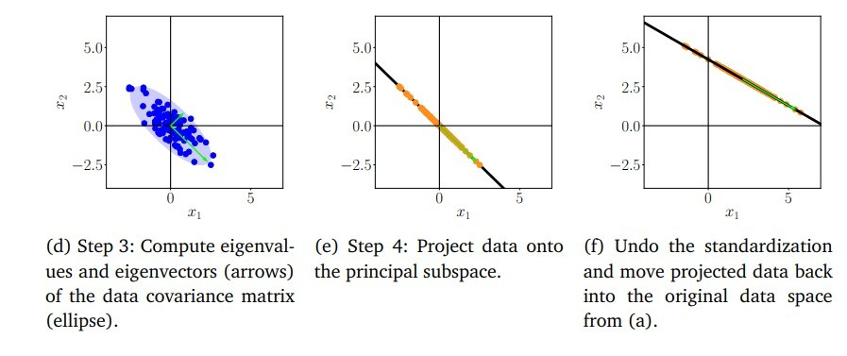
Key Steps of PCA in Practice

Slide 28
Summary of PCA
We derived PCA by maximizing the variance in the projected space
We took high-dimensional data x ∈ R^{D} and used a matrix B
to find a lower-dimensional representation z ∈ R^{M}
The columns of B are the eigenvectors of the data covariance matrix S that are associated with the largest eigenvalues.
Once we have a low-dimensional representation z , we can get a high-dimensional version of it as Bz .

